Slide 1

MEGA PROJECT ON SUSPICIOUS ACTIVITY DETECTION THROUGH VIDEO SURVEILLANCE SYSTEM
Information Technology Dept, WCE
Under guidance of Mr. P. K. Kharat
Group No: 09
Group Members:
1. Shital Dnyanoba Jadhav 2012BIT018
2. Aishwarya Adhiraj Gunde 2012BIT063
3. Radhika Sujit Tiwari 2012BIT062

Slide 2
OBJECTIVES
Management and analysis of huge amount of video data.
Study and comparisons of various algorithms for detection purpose.
Study of video processing for detecting suspicious activities in IT Department through CCTV surveillance.

Slide 3
SIGNIFICANCE
Several important research questions remain to be addressed before we can rely upon video surveillance as an effective tool for crime prevention, crime resolution, and crime protection.
Video surveillance is increasing significance approach as organizations seek to safe guard physical and capital assets.
At the same time, the necessity to observe more people, places, and things coupled with a desire to pull out more useful information.

Slide 4
BRIEF REVIEW OF LITERATURE
Sr. No. | Reference Papers | Relevance towards our project
1 | Collective control over sensitive video data using secret sharing | Performance analysis based on temporal and spatial redundancy.
2 | Moving Object Detection: Review of Recent Research Trends | Traditional Moving Object Detection Approaches
3 | Detecting abnormal behaviors in surveillance videos based on fuzzy Clustering and multiple Auto-Encoders | A novel framework to detect abnormal behaviors in surveillance videos by using fuzzy clustering and multiple Auto-Encoders (FMAE).
4 | Utility based decision support engine for camera view selection in multimedia surveillance systems | Decision Support Engine (DSE) to select and schedule most appropriate camera views that can help the operator to take an informed decision
5 | Evaluation of Background Subtraction Algorithms for Object Extraction | Simple Background Subtraction Algorithm(SBSA)

Slide 5
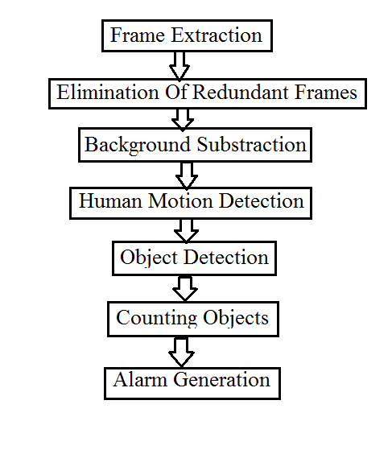
FLOW CHART

Slide 6
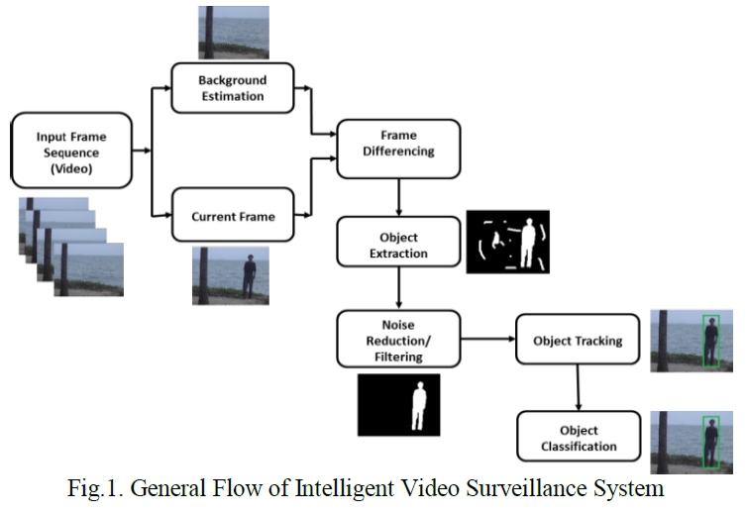

Slide 7
MATLAB: MATRIX LABORATORY
MATLAB is a multi-platform, data analysis, prototyping, and visualization tool with built-in support for matrices and matrix operations, rich graphics capabilities, and a friendly programming language and development environment.
It offers programmers the ability to edit and interact with the main functions and their parameters, which leads to valuable time savings in the software development cycle.
It has become very popular with Engineers, Scientists, and Researchers in both Industry and Academia due to many factors such as the availability of toolboxes containing specialized functions for many application areas, ranging from data acquisition to image processing.

Slide 8
DIGITAL IMAGE PROCESSING
Digital image processing can be defined as the science of modifying digital image by means of a digital computer.
Since both the images and the computers that process them are digital in nature, the focus is exclusively on digital image processing.
The changes that take place in the images are usually performed automatically and rely on carefully designed algorithms.
This is in clear contrast with another scenario, such as touching up a photo using an airbrush tool in a photo editing software, in which images are processed manually and the success of the task depends on human ability and dexterity.
We refer to the latter as image manipulation to make this distinction more explicit.

Slide 9
BACKGROUND SUBTRACTION
Background subtraction, also known as Foreground Detection, is a technique wherein an image’s foreground is extracted for further processing.
Generally an image’s regions of interest are objects (humans, cars, text etc.) in its foreground.
Background subtraction is a widely used approach for detecting moving objects in videos from static cameras.
The rationale in the approach is that of detecting the moving objects from the difference between the current frame and a reference frame, often called ‘background image’.

Slide 10
HUMAN MOTION TRACKING
Tracking is a particularly important issue in human motion analysis since it serves as a means to prepare data for pose estimation and action recognition.
For tracking a human body, important body features are extracted based on the anatomical knowledge. These essential human body points are called as motion data.
The tracking algorithms within human motion analysis usually have considerable intersection with motion segmentation during processing.
Tracking over time typically involves matching objects in consecutive frames using features such as points, lines or blobs.

Slide 11
OBJECT DETECTION
The algorithm for detecting a specific object based on finding point correspondences between the reference and the target image.
It can detect objects despite a scale change or in-plane rotation. It is also robust to small amount of out-of-plane rotation and occlusion.
This method of object detection works best for objects that exhibit non-repeating texture patterns, which give rise to unique feature matches.

Slide 12
ANOMALY DETECTION
Detecting abnormal actions or events in surveillance video is one of the most challenging analysis tasks because the abnormal samples are usually quite rare and the concept of abnormality is not well-defined on many occasions.
Since it is difficult to list all the anomaly types as well as to obtain enough abnormal samples for building models, the anomaly detection task is usually regarded as an unsupervised problem.
In this case, how to estimate normal patterns sufficiently becomes the key point.

Slide 13
REFERENCES
1. Pradeep K. Atrey, Saeed Alharthi, M. Anwar Hossain, Abdullah AlGhamdi, Abdulmotaleb El Saadik, “Collective control over sensitive video data using secret sharing”, Springer Science+Business Media New York 2013
2. Jaya S. Kulchandan, Kruti J. Dangarwala, “Moving Object Detection: Review of Recent Research Trends”, International Conference on Pervasive Computing (ICPC), IEEE, 2015
3. Zhengying Chen, Yonghong Tian, Wei Zeng, Tiejun Huang, “Detecting abnormal behaviors in surveillance videos based on fuzzy Clustering and multiple Auto-Encoders”, School of Electronics Engineering and Computer Science, Peking University, Beijing, P.R.China 100871, IEEE, 2015
4. Dewan Tanvir Ahmed · M. Anwar Hossain ·Shervin Shirmohammadi · Abdullah AlGhamdi Pradeep K. Atrey · Abdulmotaleb El Saddik , “Utility based decision support engine for camera view selection in multimedia surveillance systems”, Springer Science+Business Media New York 2012
5. Akash Gandhamal, Sanjay Talbar, “Evaluation of Background Subtraction Algorithms for Object Extraction”, International Conference on Pervasive Computing (ICPC), IEEE,2015

Slide 14
THANK YOU

